Slide 1
Data Warehousing SS ZG515
PC Reddy
Guest Faculty – WILP, BITS Pilani

Slide 2
Data Warehousing – Lecture 9
Midterm Review

Slide 3
Midterm Review
Data Warehouse
Data Mart
Corporate/Enterprise-wide
Union of all data marts
Data received from staging area
Queries on presentation resource
Structure for corporate view of data
Organized on E-R Model.
Departmental
A Single business process
STAR join(facts and Dim)
Technology optimal for data access and analysis
Structure to suit the departmental view of data

Slide 4
Midterm Review
The Dimensional Data Model
Contains the same information as the normalized model
Has far fewer tables
Grouped in coherent business categories
Pre-joins hierarchies and lookup tables resulting in fewer join paths and fewer intermediate tables
Normalized fact table with denormalized dimension tables.

Slide 5
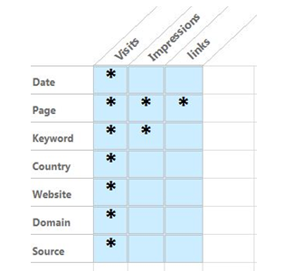
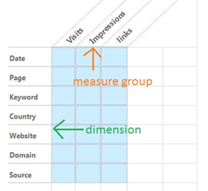
Midterm Review
Bus Architecture
An architecture that permits aggregating data across multiple marts
Conformed dimensions and attributes
Bus matrix

Slide 6
Midterm Review
A surrogate key is a unique identifier for data warehouse records that replaces source primary keys (business/natural keys)
Protect against changes in source systems
Allow integration from multiple sources
Enable rows that do not exist in source data
Track changes over time (e.g. new customer instances when addresses change)
Replace text keys with integers for efficiency

Slide 7
Midterm Review
Slowly Changing Dimensions
Attributes in a dimension that change more slowly than the fact granularity
Type 1: Current only / overwrite the old value
Type 2: All history / create a new dimensional record
Type 3: Most recent few (rare) / create a “previous value” attribute
Note: rapidly changing dimensions usually indicate the presence of a business process that should be tracked as a separate dimension or as a fact table

Slide 8
Midterm Review
Type 2 change
CustKey | BKCustID | CustName | CommDist | Gender | HomOwn?
1552 | 31421 | Jane Rider | 3 | F | N
Dimension with a slowly changing attribute
Cust Key | BKCust ID | Cust Name | Comm Dist | Gender | Hom Own? | Eff | End
1552 | 31421 | Jane Rider | 3 | F | N | 1/7/2004 | 1/1/2006
2387 | 31421 | Jane Rider | 31 | F | N | 1/2/2006 | 12/31/9999
Prod_id | Prod_cd | Name | Category
1001 | STD | Short-Term-Disability | Disability
1002 | LTD | Long-Term Disability | Disability
1003 | GUL | Group Universal Life | Life
1004 | PA | Personal Accident | Accident
1005 | VADD | Voluntary Accident | Accident

Slide 9
Midterm Review
Fact Table - in coming data
Date | CustKey | ProdKey | Item Count | Amount
1/1/2004 | 31421 | STD | 1 | 1,798.00
1/2/2004 | 31421 | STD | 1 | 27.95
1/3/2004 | 31421 | STD | 2 | 320.26
1/2/2006 | 31421 | LTD | 1 | 19.95
Fact Table
Date | CustKey | ProdKey | Item Count | Amount
1 | 1552 | 1001 | 1 | 1,798.00
2 | 1552 | 1001 | 1 | 27.95
3 | 1552 | 1001 | 2 | 320.26
731 | 1552 2387 | 1002 | 1 | 19.95

Slide 10
Data Extraction, Transformation, And Loading
Over View:
Reshape the relevant data from the source systems into useful information to be stored in the DW.
Data Extraction -> Data Transformation -> Data Loading
What is scope and extent of the data that will be extracted?
Business Requirement
Why not extract all data and dump into DW?
Select the needed data based on requirements

Slide 11
Challenges
Diverse and disparate source systems
Multiple platforms and different operating systems
Older legacy systems
Quality of data in old systems
Source system structure keep changing
Lack of consistency

Slide 12
Data Extraction & Static Data Capture
Data Extraction:
Data in operational systems
Current Value
Periodic Status
Data Extraction Types
As Is (Static) Data Capture
Data of Revisions (Incremental Data Capture)
Static Data Capture
Capture of data at a given point time
Taking snapshot of relevant source data
Primarily for initial load of data to DW
Full refresh of Dimensional Tables

Slide 13
Incremental Data Capture
For revisions since the last time data was captured
Can be Immediate or Deferred
Immediate Data Extraction
- data extraction is real-time.
Capture through transaction logs – Replication Technology
Capture through database triggers
Capture in source applications
Deferred Data Extraction
- Do not capture the date in real-time
Capture based on Date and Time Stamp
Capture by Comparing Files

Slide 14
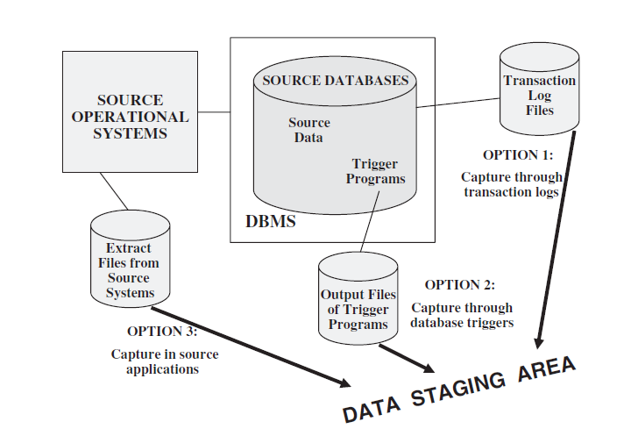
Immediate Data Extraction

Slide 15
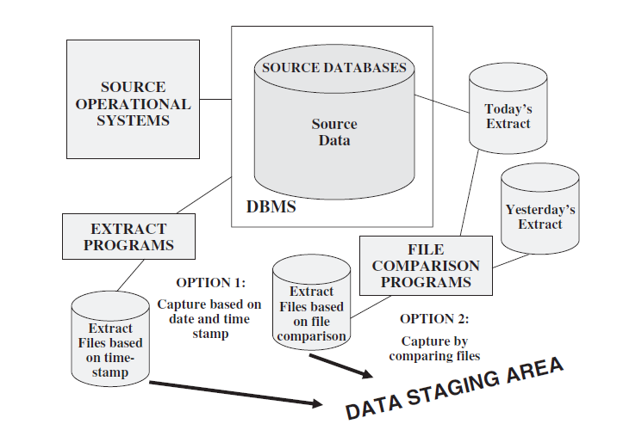
Deferred Data Extraction

Slide 16
Data Transformation
Basic Tasks
Selection
Splitting/Joining
Conversion
Summarization
Enrichment
Major Types
Format Revisions
Decoding of Fields
Calculated and Derived Values
Splitting of Single Fields
Merging of Information
Character set conversion and Unit Measure Conversions
Date/Time Conversion
Key Restructuring
Deduplication

Slide 17
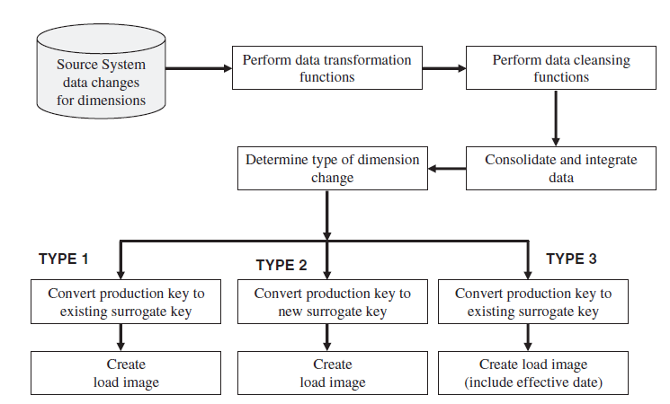
Transformation for Dimension Attributes

Slide 18
Data Loading
Take the prepared data, apply it to DW, and store in DB.
Different ways of moving data –
Initial load
Incremental load
Full Refresh
General methods for applying data –
Writing special load programs
Load utilities of DBMSs

Slide 19
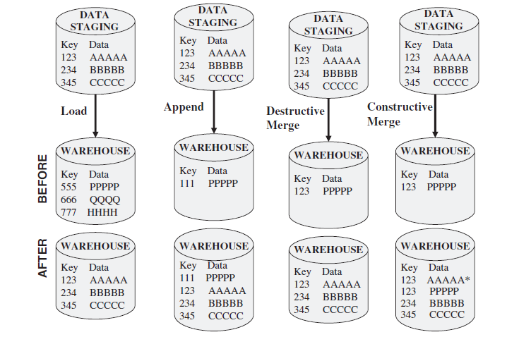
Applying Data

Slide 20
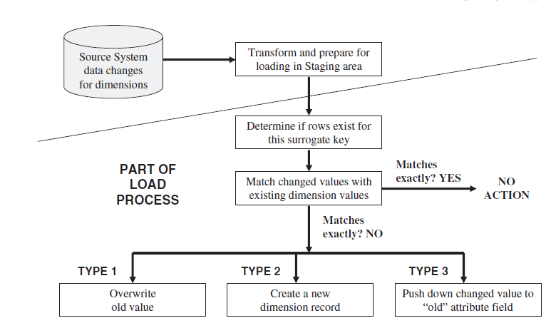
Loading Data in Dimension Tables

Slide 21
Data Loads in Fact Tables
Dimension records are loaded first
Create concatenated key for fact table record from the dimension records.
History Loads for fact tables
Incremental loads for fact tables

Slide 22
Aggregating Fact Tables
Aggregate fact tables are summaries of the most granular data at higher levels along the dimension hierarchies.
Hierarchy
levels
Product key
Product
Category
Department
Store key
Store name
Territory
Region
Product key
Time key
Store key
Unit sales
Sale dollars
Time key
Date Month
Quarter
Year
Multi-way aggregates:
Territory – Category – Month
(Data values at higher level)

Slide 23
3-Tier Data warehouse Architecture
Data warehouses often adopt a 3-tier architecture:
Bottom Tier – Data warehouse Server
Middle Tier – OLAP Server
Top Tier – Front end tools

Slide 24
Bottom Tier
It is a warehouse database server (mostly a Relational Database System)
Data is fed using back end tools and utilities (Extract, Clean, Transform, Load and Refresh)
Data is extracted using programs called Gateways (ODBC, JDBC)
It also contains Meta data repository

Slide 25
Back-end Tools and Utilities
Data Extraction – typically gathers data from multiple, heterogeneous and external sources.
Data Cleaning – detects errors in the data and rectifies them when possible
Data Transformation – converts data from host format to warehouse format
Load – sorts, summarizes, consolidates, computes views, checks integrity and builds indices and partitions
Refresh – updates from the data sources to warehouse

Slide 26
Metadata Repository
It contains:
Structure of data warehouse
Operational Metadata
Extraction and Transformation Metadata
End-User Metadata
Data related to system performance
Algorithm used for summarization

Slide 27
Middle Tier
It is an OLAP server that is typically implemented using either ROLAP or MOLAP
ROLAP - relational OLAP model, an extended relational DBMS that maps operations on multidimensional data to standard relational operations
MOLAP -multidimensional OLAP model, a special-purpose server that directly implements multidimensional data and operations.

Slide 28
Top Tier
It is a front-end client layer, which contains
query and reporting tools, analysis tools, and/or data mining tools (e.g., trend analysis, prediction, and so on).

Slide 29
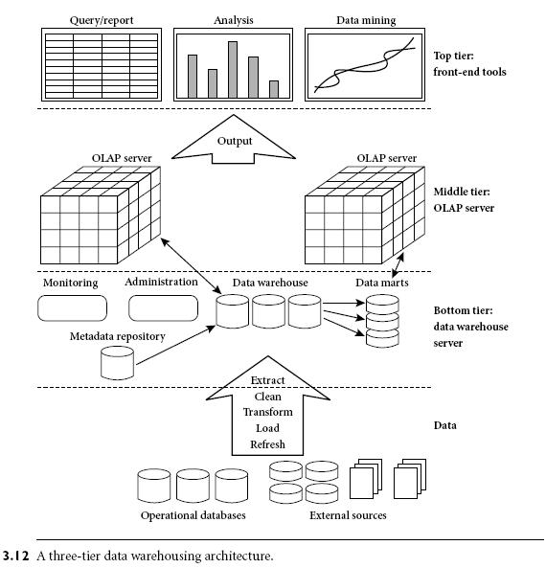

Slide 30
Hypercubes
Multi-dimension cubes
Hard to visualize and display beyond three dimensions
Multi-dimensional domain structure (MDS)
Represents each dimension as a line showing the values
A multidimensional database (MDD) is a computer software system designed to allow for the efficient and convenient storage and retrieval of large volumes of data that is (1) intimately related and (2) stored, viewed and analyzed from different perspectives. These perspectives are called dimensions

Slide 31
Relational Vs
Multi-Dimensional Models
The Relational Structure

Slide 32
Relational Vs
Multi-Dimensional Models
Multidimensional Array Structure
Measurement
Dimension
Dimension
Positions

Slide 33
MOLAP Implementations
OLAP has historically been implemented through use of multi-dimensional databases (MDDs).
Dimensions are key business factors for analysis:
geographies (zip, state, region,...)
products (item, product category, product department,...)
dates (day, week, month, quarter, year,...)
Very high performance via fast look-up into “cube” data structure to retrieve pre-calculated results.
“Cube” data structures allow pre-calculation of aggregate results for each possible combination of dimensional values.
Use of application programming interface (API) for access via front-end tools.

Slide 34
MOLAP Implementations
Need to consider both maintenance and storage implications when designing strategy for when to build cubes.
Maintenance Considerations: Every data item received into MDD must be aggregated into every cube (assuming “to-date” summaries are maintained).
Storage Considerations: Although cubes get much smaller (e.g., more dense) as dimensions get less detailed (e.g., year vs. day), storage implications for building hundreds of cubes can be significant.

Slide 35
Midterm Review
Questions ??

